Slide 1
Word Embeddings and Feature Importance
Noun Experiment Gender
Celine Zyna Rahme
Chenhan Gao
Muhammad Tayyab
Stephanie Ounanian

Slide 2
Table of Contents
01
02
03
04
05
06
07
08
Introduction
Dataset & Word Embeddings
Experiment Workflow
Classifier Training & Accuracy
SHAP & LIME
Results
Advanced XAI Techniques
What Comes After SHAP and LIME?

Slide 3

Introduction
Analyze how well word embeddings capture French noun gender
Train a perceptron classifier using embeddings from 10 pre-trained models
Apply SHAP/LIME for feature selection and retrain with key features
Compare performance to determine which embeddings best encode gender information
Evaluate if feature selection improves classification accuracy

Slide 4
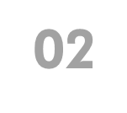
Dataset & Word Embeddings
Morphalou 3.0
10 Pre-trained Models
A French lexicon that provides noun gender annotations, ensuring a balanced distribution of masculine and feminine nouns.
CamemBERT (Base)
DistilBERT
FlauBERT (Small Cased, Base Cased, Base Uncased, Large)
mBERT (Base Cased, Base Uncased)
XLM-R (Base, Large)

Slide 5
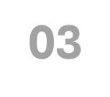
Experiment Workflow
Model Selection:
Extract Word Embeddings : - We use the same 10 models as Ekaterina - Process embeddings and store them for further classification preprocessing
Word Embedding Extraction:
Convert each noun into a vector representation
Extract embeddings from all 10 models
Store embeddings for further classification
Train Perceptron Classifier:
Train a simple perceptron classifier on full embeddings (80-20 train-test split)
Establish baseline accuracy for comparison

Slide 6
Experiment Workflow
Feature Selection with SHAP & LIME:
Apply SHAP and LIME separately to rank important dimensions
Compare feature rankings from both methods
Top-N Feature:
Based on SHAP/LIME scores, we retain only the most important embedding dimensions (top N%)
Retrain the classifier with Important Features:
Instead of using all 768 features, train a perceptron with only top-ranked features
Compare accuracy before and after feature selection
Performance Comparison:
Evaluate if feature-selected embeddings improve classification accuracy
Compare performance to using all embedding dimensions
Benchmark results against Ekaterina’s findings
Analysis & Insights:
Identify shared important features across models
Compare insights with Ekaterina’s results

Slide 7
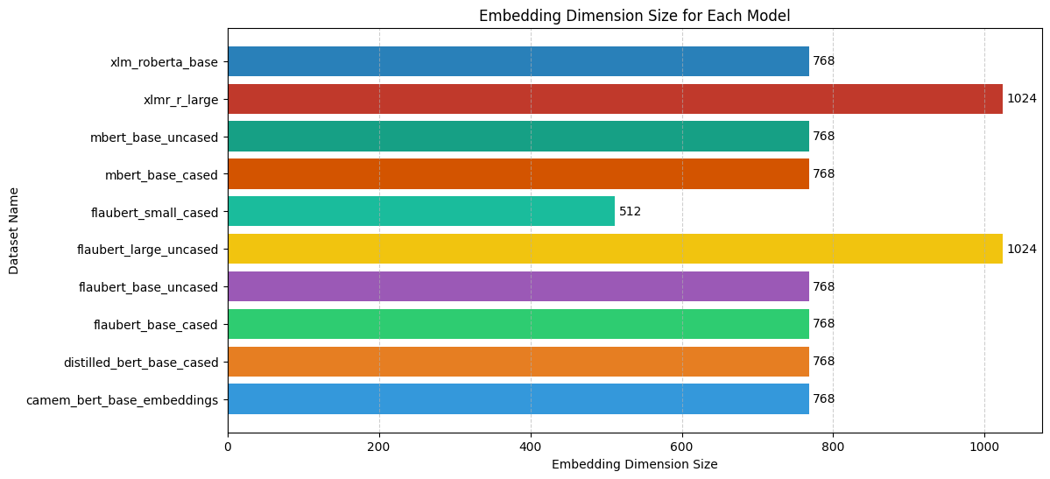
Experiment Workflow
Dataset Loading: Downloading and loading French noun embeddings datasets.
Exploratory Data Analysis (EDA):
Plotting embedding dimensions for each model.
Analyzing gender distribution in datasets.
Applying undersampling to balance datasets.

Slide 8
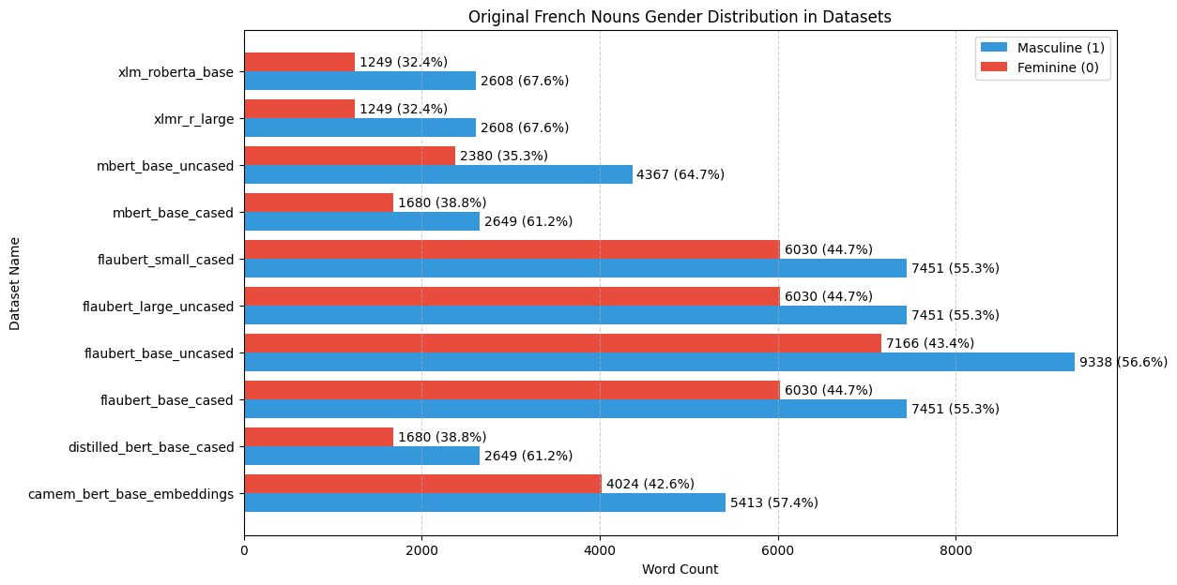
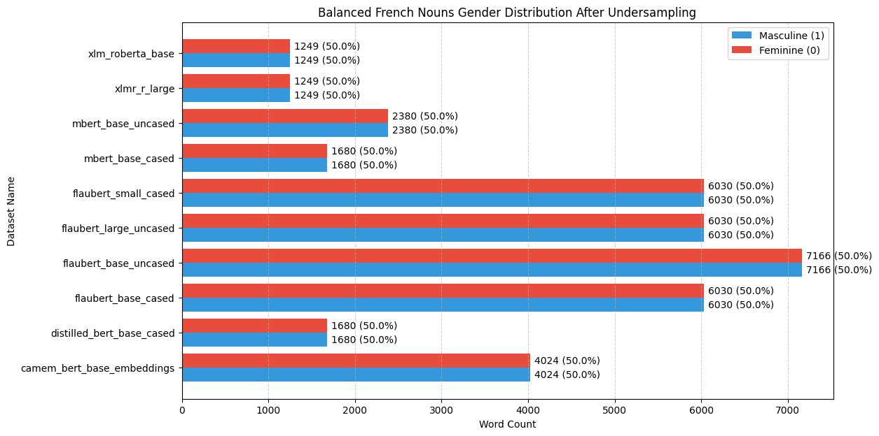
Experiment Workflow

Slide 9
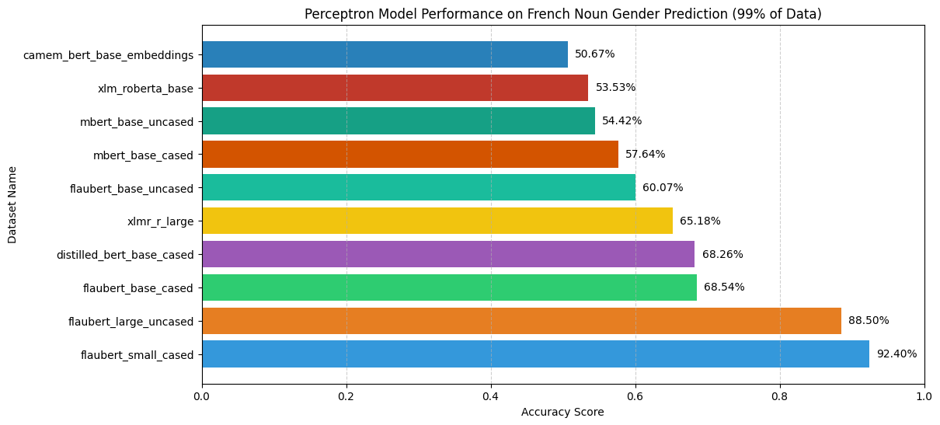
04
Classifier Training & Accuracy
Training the Model:
Training a simple perceptron model for each embedding dataset
Use an 80-20 train-test-split
Plotting accuracy scores across different embedding models.

Slide 10

SHAP & LIME
SHAP(SHapley Additive exPlanations)
LIME(Local Interpretable Model-agnostic Explanations)
Assigns importance scores to each embedding dimension
Computes Shapley values by evaluating all possible feature combinations.
Helps identify features that influence noun gender predictions the most
Higher SHAP values indicate stronger contributions to classification
More computationally expensive because it evaluates many feature subsets.
Creates a simple, interpretable model (linear regression) to approximate the complex model’s behavior.
Perturbs (slightly changes) input data and observes how the model's predictions change.
Explains individual predictions, making it useful for understanding why a model classified a specific word as masculine or feminine.
Does not consider feature interactions, treating each feature independently.
Faster and more efficient compared to SHAP but can be less stable.

Slide 11
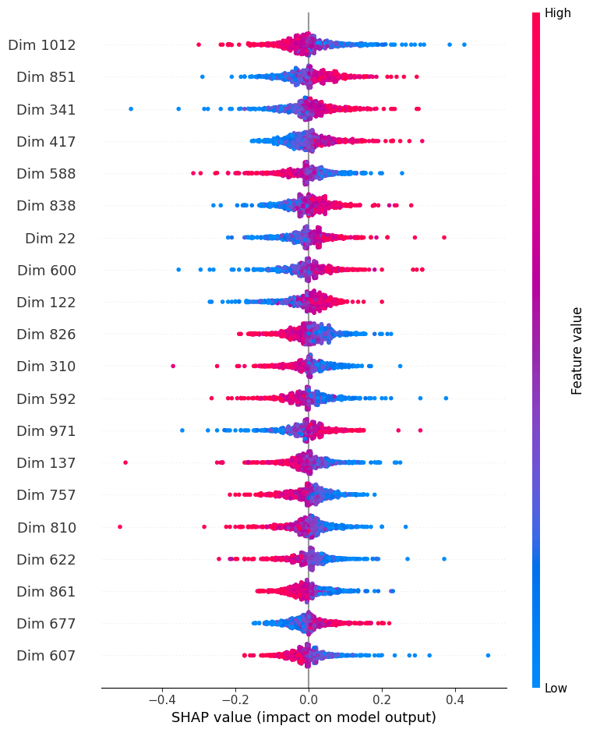
SHAP : Understanding Feature Importance
Why Use SHAP?
Identifies the most informative embedding dimensions.
Helps in feature selection to improve model accuracy and efficiency
Compute SHAP Importance for Each Model
Extracts feature importance scores for all embedding dimensions
Uses SHAP to analyze how each dimension contributes to predictions
Saving SHAP feature importance results

Slide 12
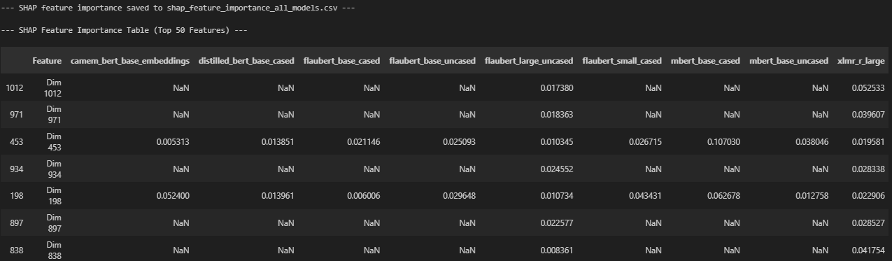
SHAP : Understanding Feature Importance
Aggregate and Compare Across Models
Aligns feature importance scores across all models
Creates a ranked list of the most important features

Slide 13
SHAP : Understanding Feature Importance
Retrain Perceptron with Top Features:
Selects top N features based on SHAP scores
Trains a new perceptron using only these high-importance dimensions
Evaluate Performance Impact:
Compares accuracy of the baseline model vs. models trained with top SHAP features
Analyzes whether feature selection improves classification

Slide 14
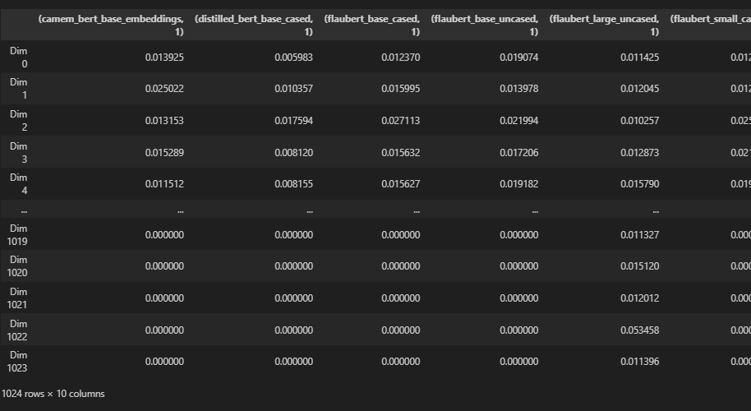
LIME : Understanding Feature importance
Select Sample Words for LIME Analysis
Sampled words from dataset, ensuring class balance (feminine vs. masculine)
Used 1% of French Nouns from the dataset to get the LIME scores and aggregated
Apply LIME to Trained Models
Generate explanations for each word using LIME
Identify important embedding dimensions contributing to classification
Aggregate Feature Importance Across Models
Normalize and store LIME feature rankings
Align results across different pre-trained embeddings
Select top N% Important features
Retrain Perceptron classifier using only selected features
Performing of all features vs Lime-Selected features

Slide 15
LIME : Understanding Feature importance
Compare Performance Against Baseline
Evaluate accuracy of models using full embeddings vs. LIME-selected features
Visualize performance trends for different feature selection levels

Slide 16
SHAP & LIME vs. Ekaterina
Objective: Compare SHAP and LIME feature importance rankings with Ekaterina’s Perceptron dimensions.
Datasets Used:
SHAP Feature Importance (computed for all models).
LIME Feature Importance (local model-based feature impact, 1% French Nouns used from the Dataset).
Ekaterina's Stable Gender Features (reference data from the report).
Extracting SHAP & LIME Features Per Model (Process)
Sort importance values (SHAP or LIME) for each model.
Select top N% most important features.
Extract and store the top features for further analysis.
Compare feature rankings between SHAP and LIME for each model.
✅ Outcome: Identify and compare key features influencing noun gender predictions across models.
Extract & Clean Ekaterina Features

Slide 17
Common Features: S/L Top N% vs. Ekaterina
Identify and quantify the overlap of top features selected by SHAP/LIME with Ekaterina's feature set.
Process Overview:
Feature Comparison
For each model, compare top features from SHAP and LIME with Ekaterina's feature sets.
Extract and store common features for each top N% group .
Overlap Calculation
Calculate the percentage of overlap between top SHAP/LIME features and Ekaterina's features.
Store the overlap percentage for each model and feature group.
Results
Display and save the prediction accuracies and number of common features and their percentage overlap for both SHAP and LIME vs Ekaterina

Slide 18
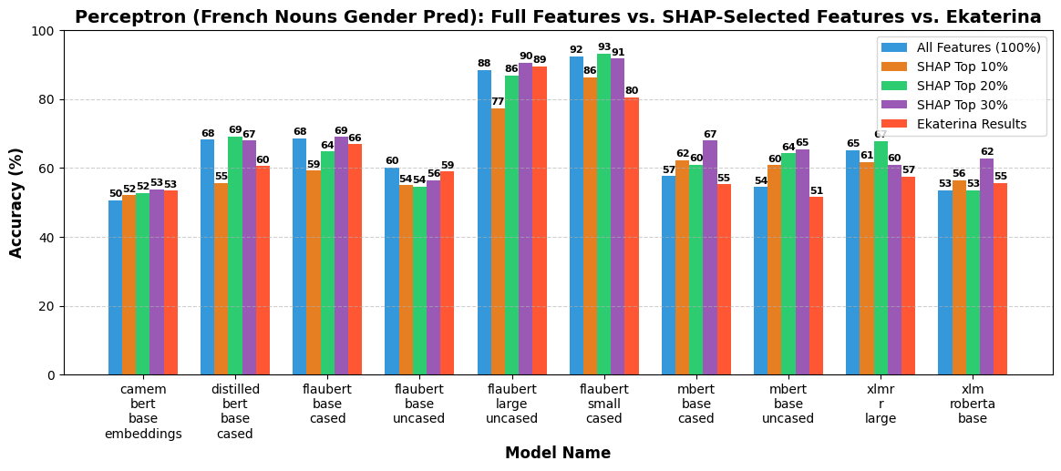
All Features vs. SHAP vs. Ekaterina

Slide 19
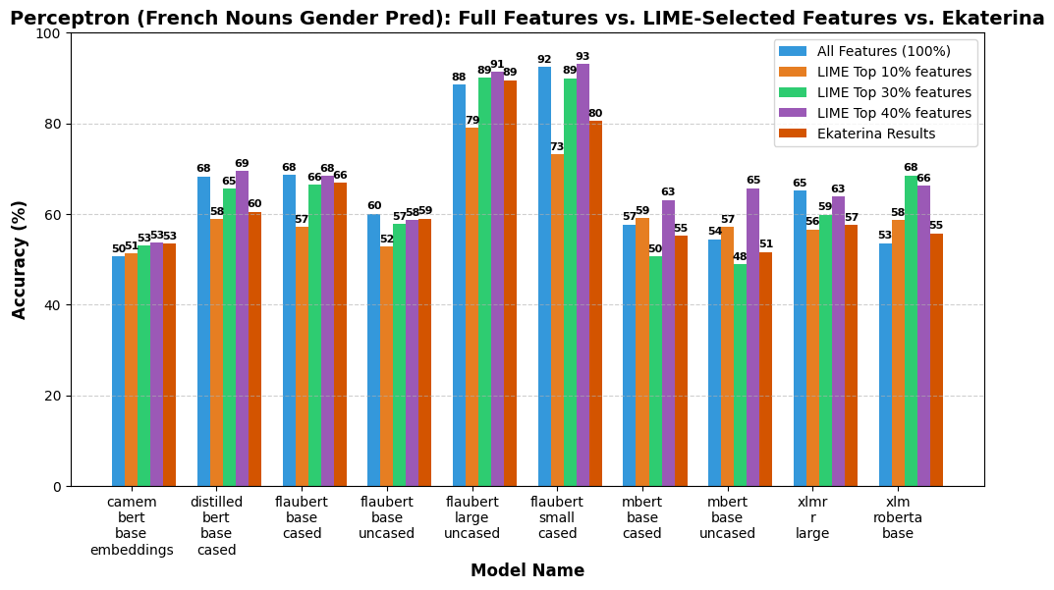
All Features vs. LIME vs. Ekaterina

Slide 20
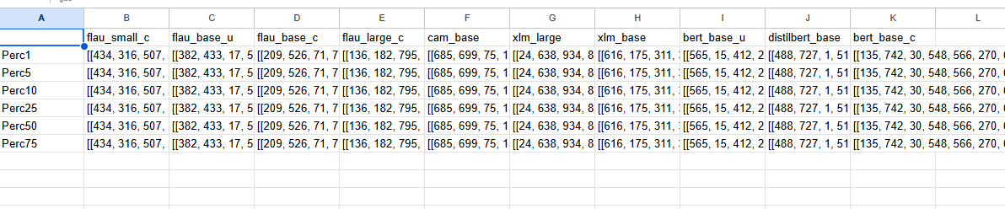
Perceptron_Gender_Noun_Dimensions_
Ekaterina

Slide 21
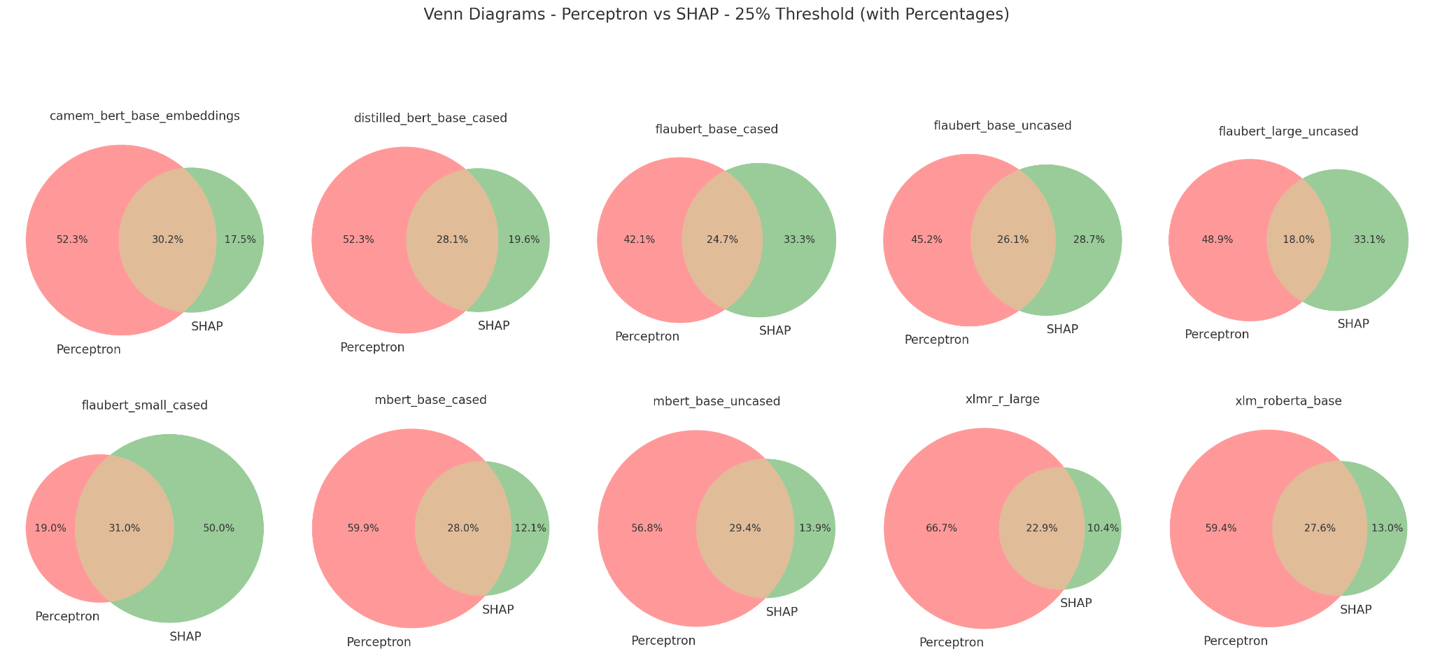
SHAP vs. Ekaterina Shared Dimensions (Top = N=25%)

Slide 22
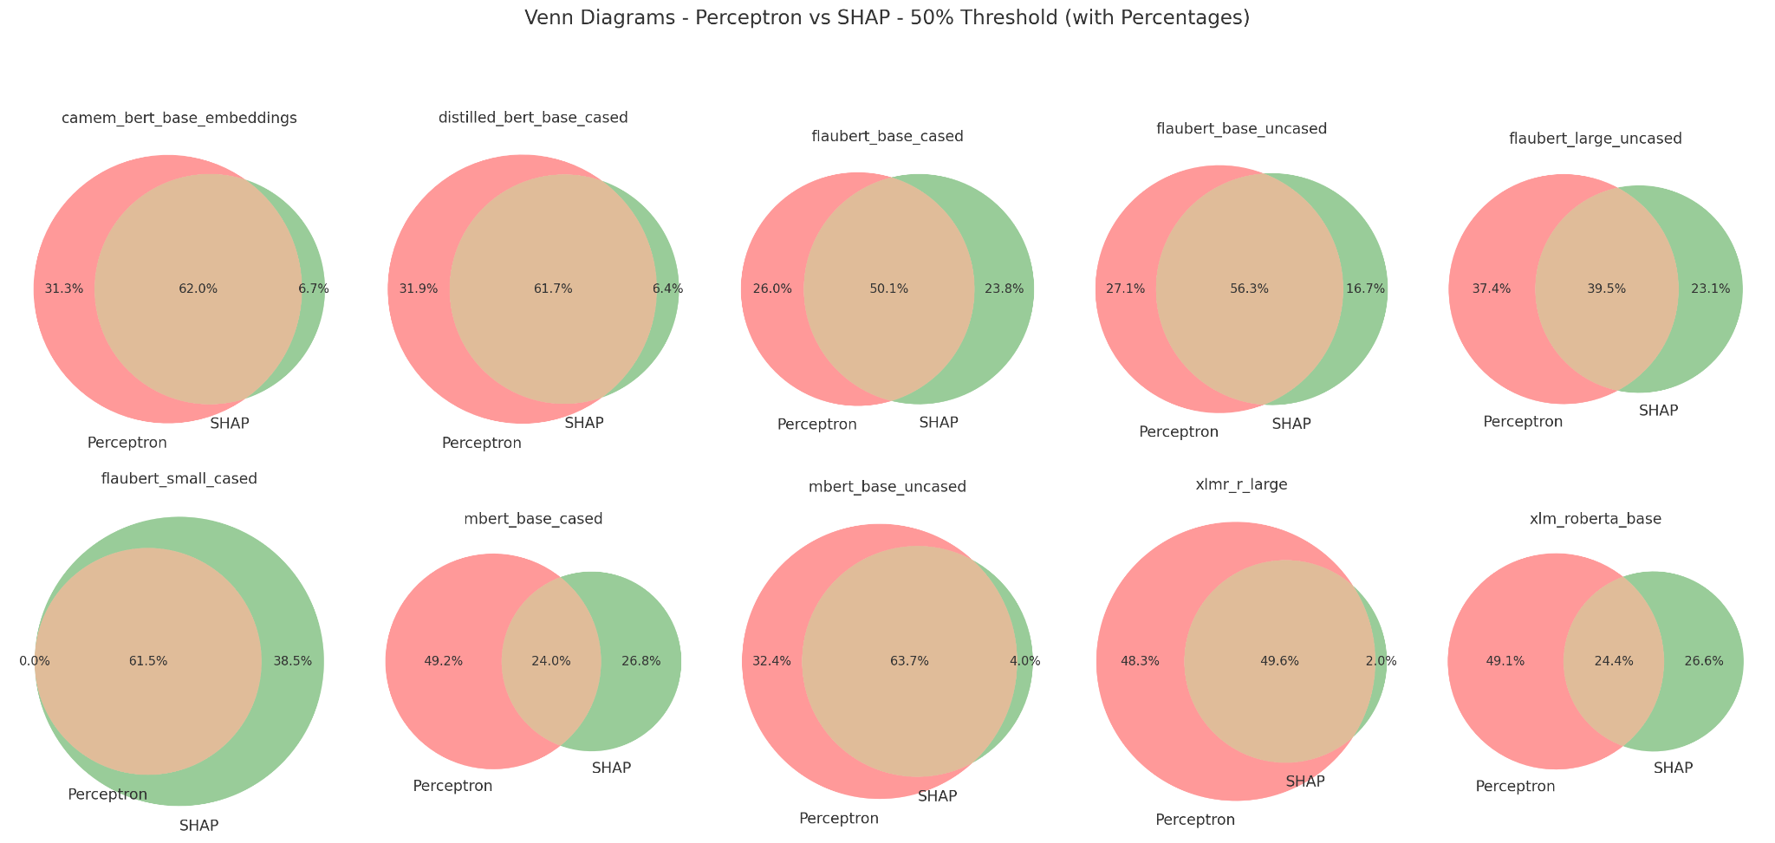
SHAP vs. Ekaterina Shared Dimensions (Top N=50%)

Slide 23
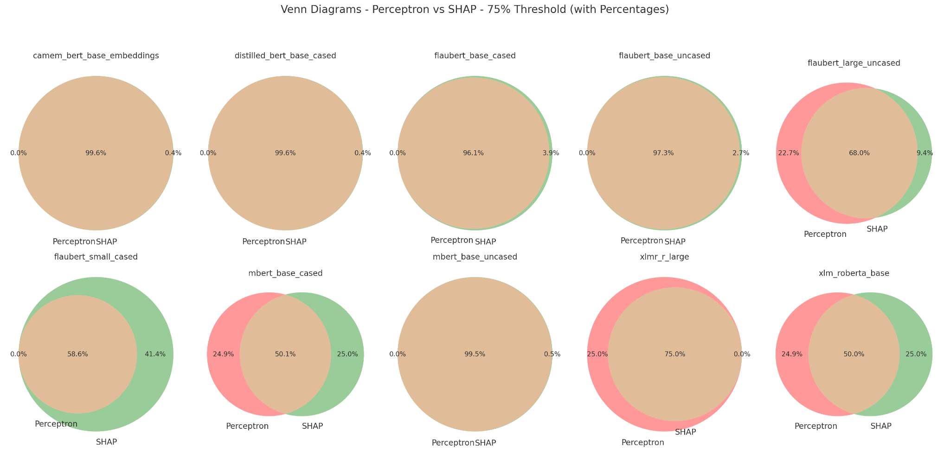
SHAP vs. Ekaterina Shared Dimensions (Top N=75%)

Slide 24
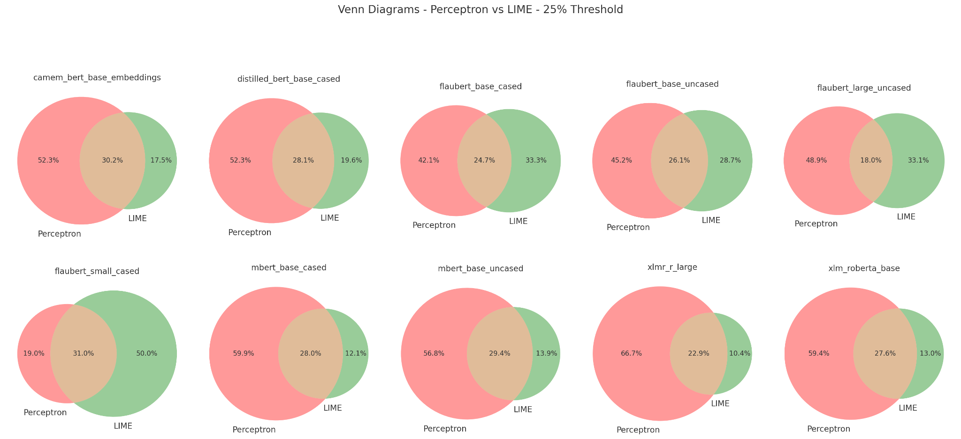
LIME vs. Ekaterina Shared Dimensions (Top N=25%)

Slide 25
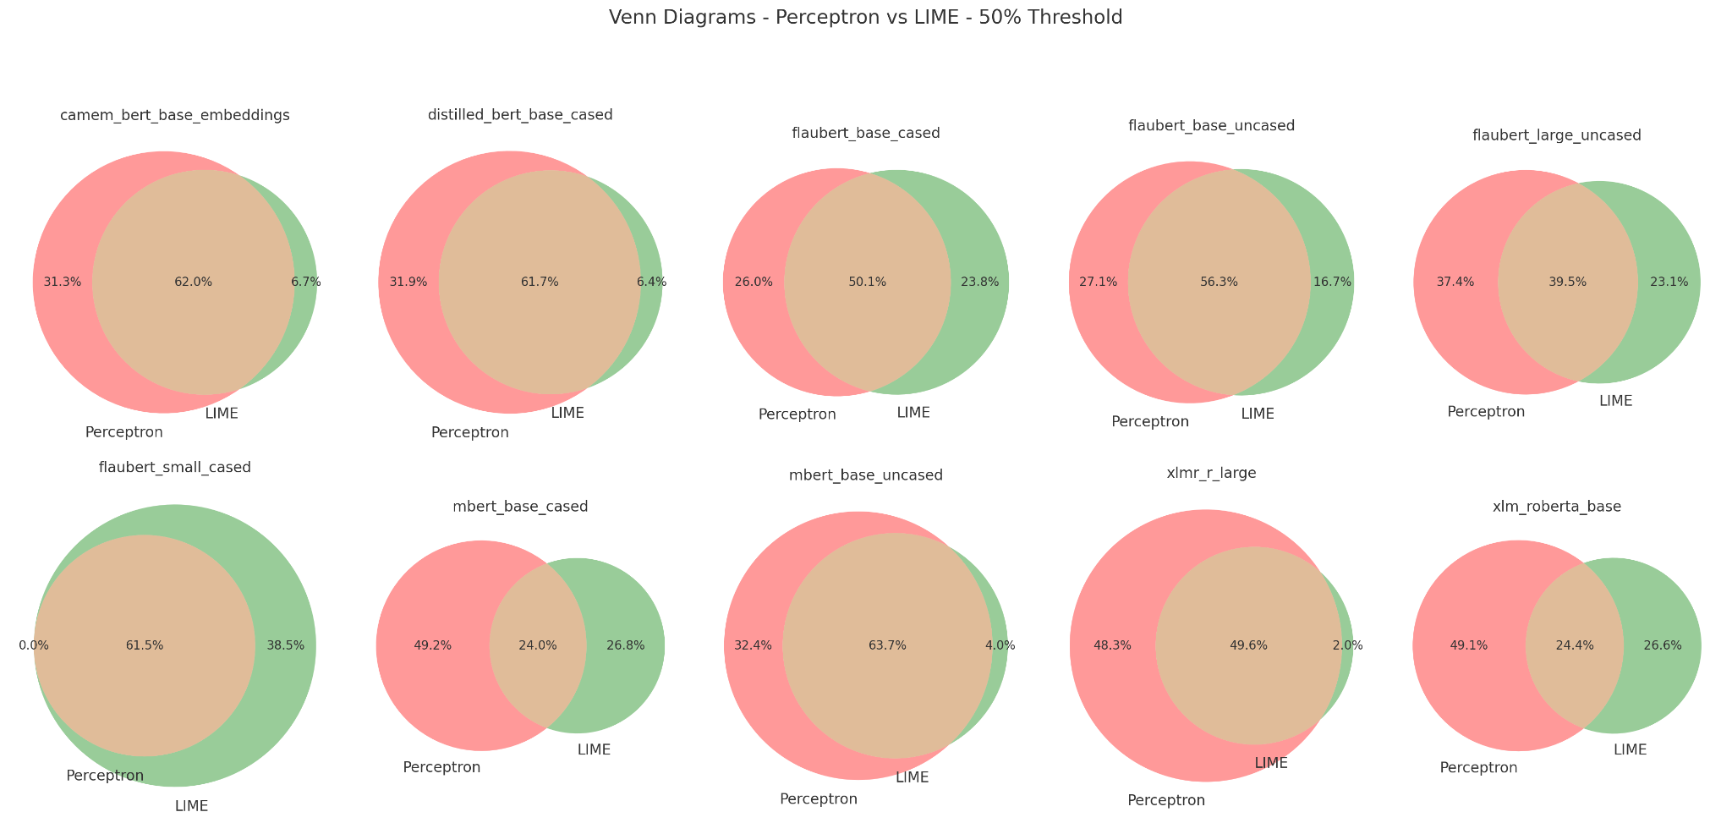
LIME vs. Ekaterina Shared Dimensions (Top N=50%)

Slide 26
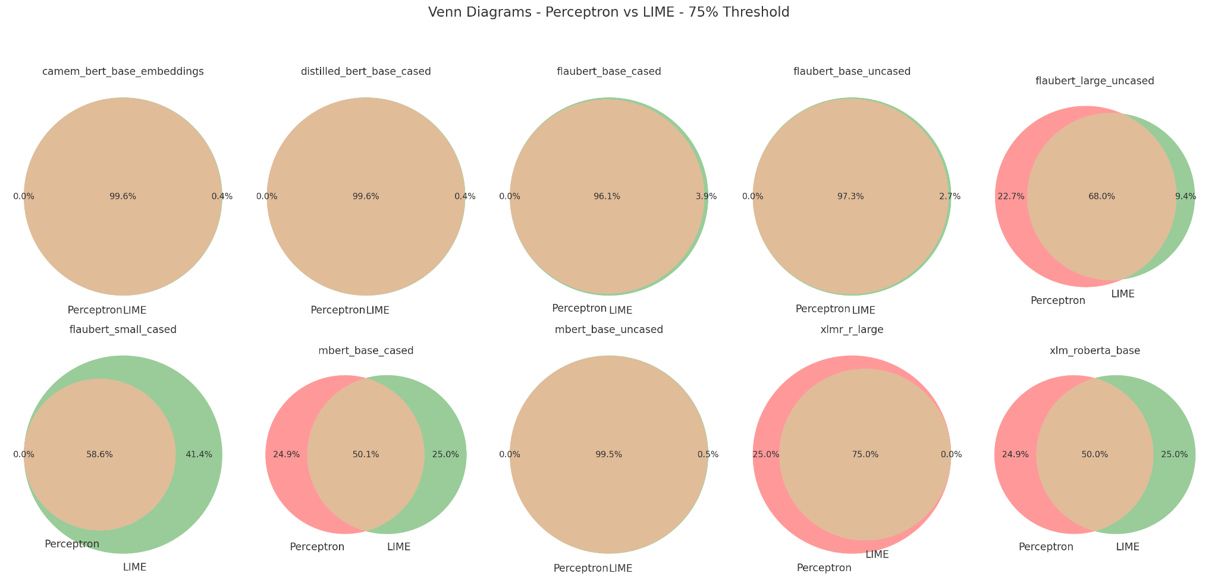
LIME vs. Ekaterina Shared Dimensions (Top N=75%)

Slide 27
07
Beyond SHAP and LIME
Beyond SHAP and LIME, advanced Explainable AI (XAI) techniques have been developed:
Feature Attribution Methods:
Methods like Integrated Gradients, Deep SHAP, and LRP explain deep learning models.
Counterfactual Explanations:
Show "what-if" scenarios using DiCE and Wachter’s Approach to highlight minimal changes that alter outcomes.
Concept-Based Explanations:
Tools like TCAV and ProtoPNet explain decisions using human-interpretable concepts.
Graph and Rule-Based Methods:
GNNExplainer (for graph models) and Anchors (rule-based local explanations).
Causal and Hybrid Approaches:
Causal SHAP integrates causality, and Self-Explaining Neural Networks (SENN) make models inherently interpretable.

Slide 28
08
What comes after SHAP and LIME?
The field of XAI continues to evolve, with several emerging directions:
Human-Centric & Interactive XAI:
AI explanations tailored to users, enabling dynamic interaction.
Multi-Modal Explainability:
Unified models that explain decisions across text, images, and structured data.
Self-Interpretable AI:
Models designed for transparency, eliminating the need for post-hoc explanations.
Automated Explanation Selection:
AI-driven systems that adapt and choose the best explanation method based on context.

Slide 29
Thank you

